Slide 1
Big Mountain Ski Resort
Guided Capstone Project
By: Kamaal Bartlett

Slide 2
What is the problem for Big Mountain Ski Resort?
Looking to increase ticket prices or reduce operating costs
Resort is competing with over 300 other ski resorts
Due to heavy competition, any decision made must be weighed against competitors and the market

Slide 3
What is the problem for Big Mountain Ski Resort?
The amount of data needed to answer this question is limited
How big of a factor do the population and square mileage per state play into a resort’s flexibility with pricing?

Slide 4
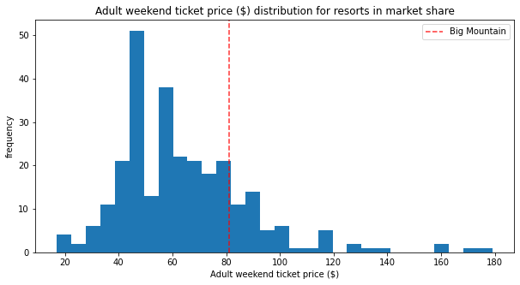
Recommendation and Key Findings
Big Mountain Ski Resort is undercharging compared to the competition
There is room for a price increase
Customers should be receptive to increased ticket prices
Revenue will grow tremendously

Slide 5
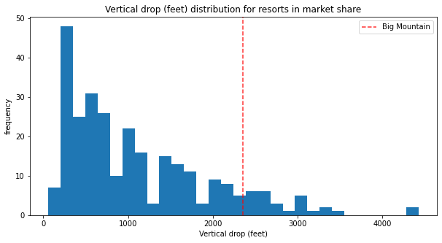
Recommendation and Key Findings
Big Mountain amongst resorts with largest vertical drop
Vertical Drop closely correlated with ticket prices
Resort should increase the vertical drop distance

Slide 6
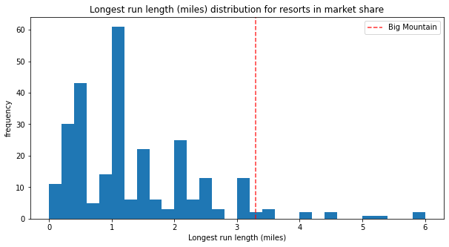
Recommendation and Key Findings
Big Mountain has one of the longest run lengths
The few ahead are only outliers
Run length closely correlated with ticket prices

Slide 7
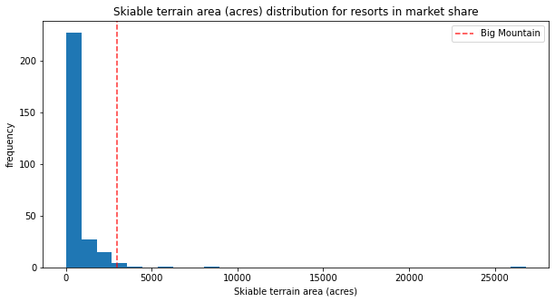
Recommendation and Key Findings
Big Mountain amongst resorts with the largest skiable area
Shows that the resort has room to grow
Allows a premium price to be charged for tickets

Slide 8
Recommendations
Increase the ticket price from $81 to $93
Increase the vertical drop by 150
Install an additional chair lift
Do not increase the current snowmaking coverage

